Slide 1
Approximating the integral using least-squares best-fitting polynomials

Slide 2
Introduction
In this topic, we will
Discuss how to estimate an integral of data by using the least-squares best-fitting polynomials
Estimating or where
Describe the formula for both linear and quadratic polynomials

Slide 3
Approximating the integral
Suppose we have found the least-squares linear polynomial that passes through N equally-spaced points
We want to integrate that line over the last time interval
The least-squares linear polynomial is a₁t + a₀ so we integrate
Again, we scaled, and thus we must account for this:
y_{n}
y_{n–2}
a₁t + a₀
y_{n–1}
y_{n–4}
y_{n–3}
–4
–3
–2
–1
0
1

Slide 4
Approximating the integral
Similarly, we can estimate the integral over the next time interval:
Once again, we account for scaling:
y_{n}
y_{n–2}
a₁t + a₀
y_{n–1}
y_{n–4}
y_{n–3}
–4
–3
–2
–1
0
1

Slide 5
Approximating the integral
We can perform the same operation for a least-squares quadratic polynomial
y_{n}
y_{n–2}
a₂t² + a₁t + a₀
y_{n–1}
y_{n–4}
y_{n–3}
–4
–3
–2
–1
0
1

Slide 6
Summary
Following this topic, you now
Understand how to estimate the integral using least-squares best-fitting polynomials
Are aware that we can both estimate the integral over the last time interval, or extrapolate and estimate the integral over the next time interval
Understand that if we already have the coefficients, we can find these estimates in O(1) time

Slide 7
References
[1] https://en.wikipedia.org/wiki/Least_squares

Slide 8
Acknowledgments
None so far.

Slide 9
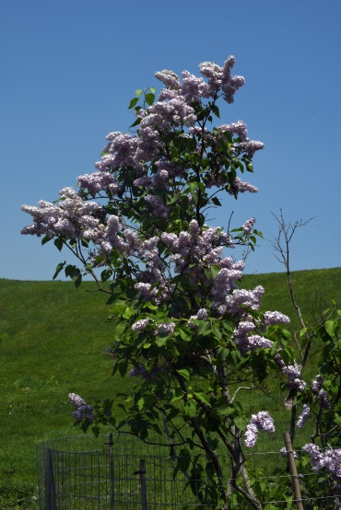
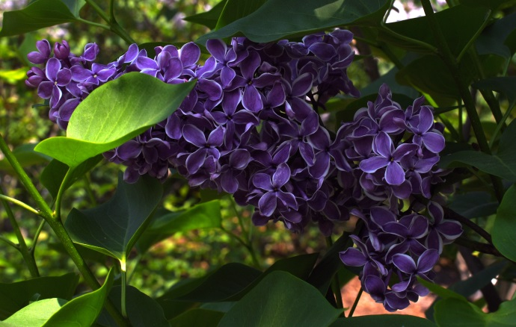
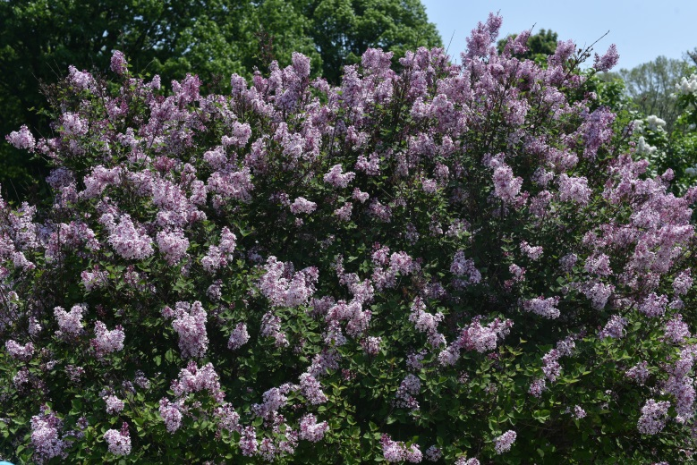
Colophon
These slides were prepared using the Cambria typeface. Mathematical equations use Times New Roman, and source code is presented using Consolas. Mathematical equations are prepared in MathType by Design Science, Inc.
Examples may be formulated and checked using Maple by Maplesoft, Inc.
The photographs of flowers and a monarch butter appearing on the title slide and accenting the top of each other slide were taken at the Royal Botanical Gardens in October of 2017 by Douglas Wilhelm Harder. Please see
https://www.rbg.ca/
for more information.

Slide 10
Disclaimer
These slides are provided for the ece 204 Numerical methods course taught at the University of Waterloo. The material in it reflects the author’s best judgment in light of the information available to them at the time of preparation. Any reliance on these course slides by any party for any other purpose are the responsibility of such parties. The authors accept no responsibility for damages, if any, suffered by any party as a result of decisions made or actions based on these course slides for any other purpose than that for which it was intended.

